Slide 1

2021 Tokyo Olympic
Bradley barker
Darryl Connelly ii
uchenna nwagbara
Yingying li

Slide 2
Work Flow
Data Source
ETL
Construction
Deployment
2021 Olympics Data
Athletes Details
Medal Total by Country
Discipline Details
Transformed and cleaned the data
Created a SQL database to store data
Used JavaScript and HTML/CSS to create visualizations for the webpages
To be continued

Slide 3
Deliverables: Overview
Create a Home page as well as 3 different detail pages for our Medals summary, Athletes summary, and a Fun facts page.
Create 3 visualizations from our data on the 2021 Olympics. (Leaderboard, Athlete count by gender, Discipline with most athletes, Top 10 Countries with the most medals).
Create a database which holds all of our cleaned data.

Slide 4
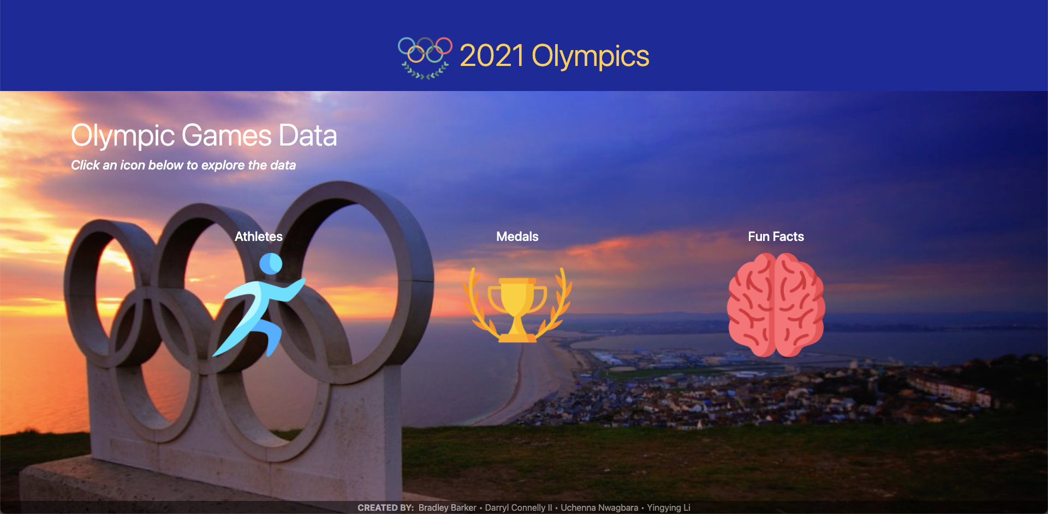
Deliverables: Landing Page (P1)

Slide 5
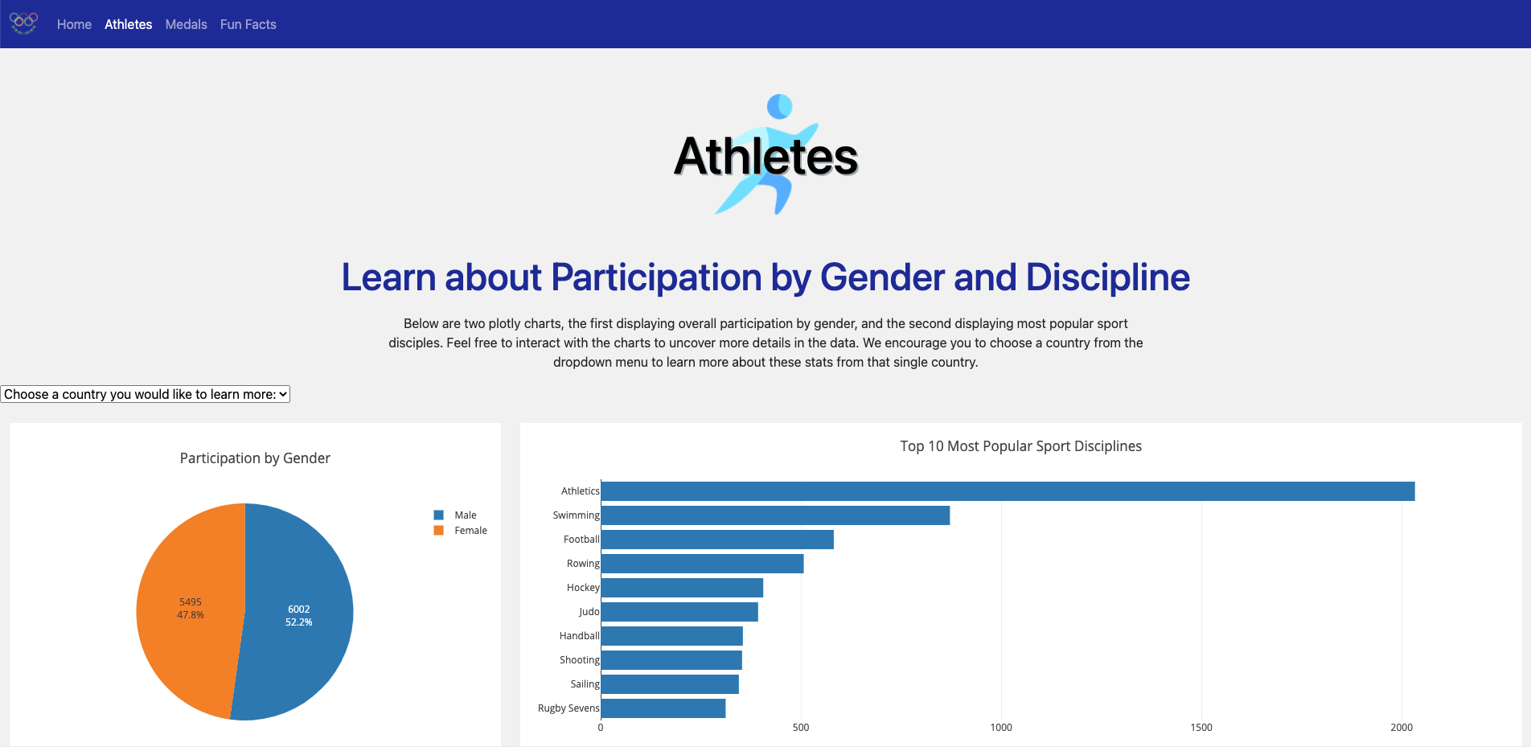
Deliverables: Athletes Summary (P2)

Slide 6
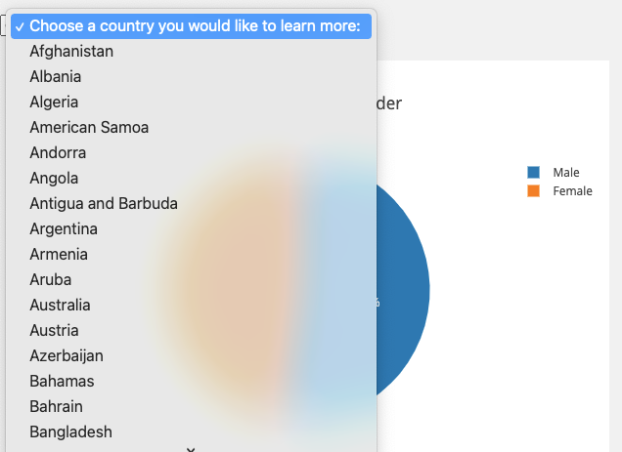
Deliverables: Athletes Summary (P2)

Slide 7
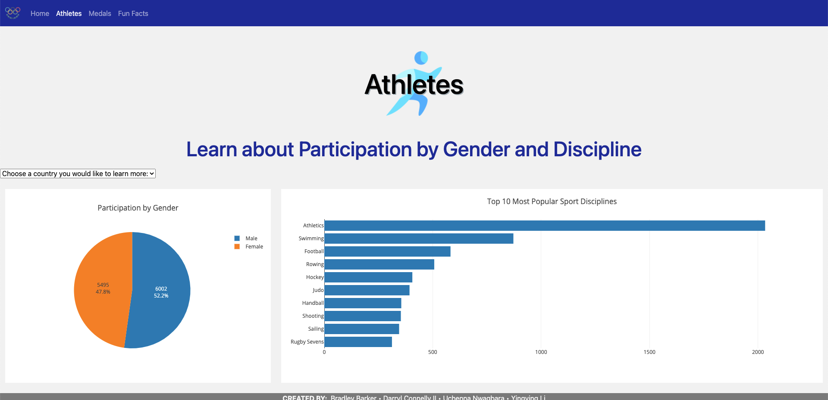
Deliverables: Athletes Summary (P2)

Slide 8
Deliverables: Athletes Summary (P2)

Slide 9
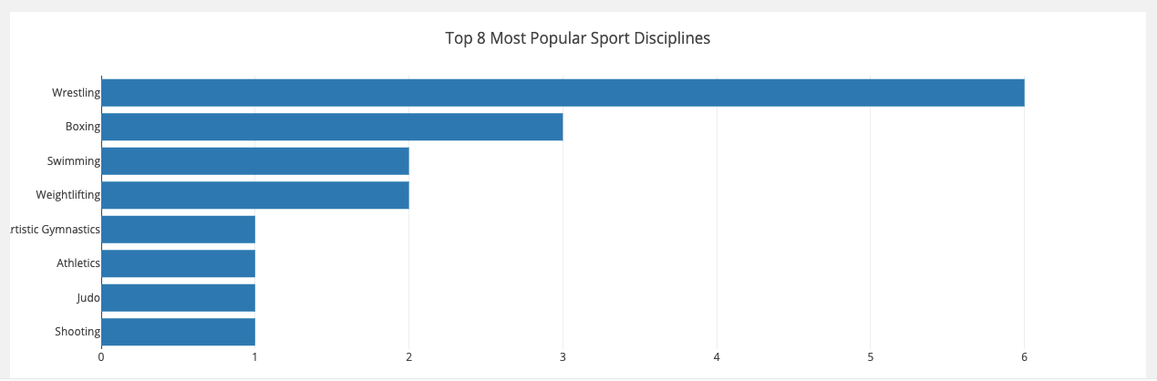
Deliverables: Athletes Summary (P2)

Slide 10
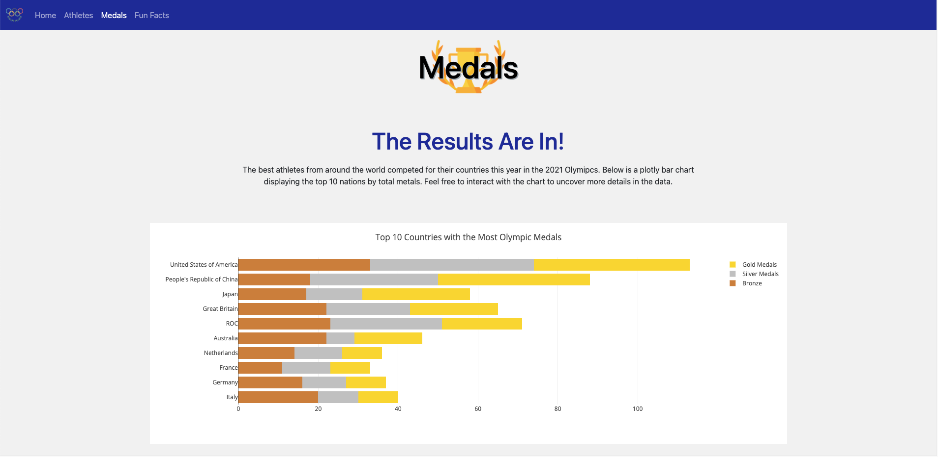
Deliverables: Medal Summary (P3)

Slide 11
Deliverables: Medal Summary (P3)

Slide 12
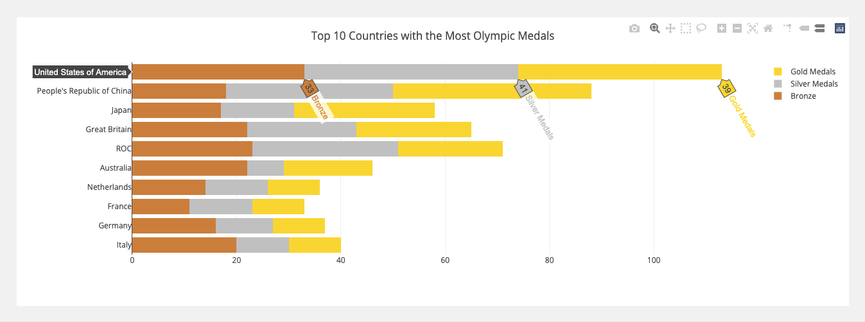
Deliverables: Medal Summary (P3)

Slide 13
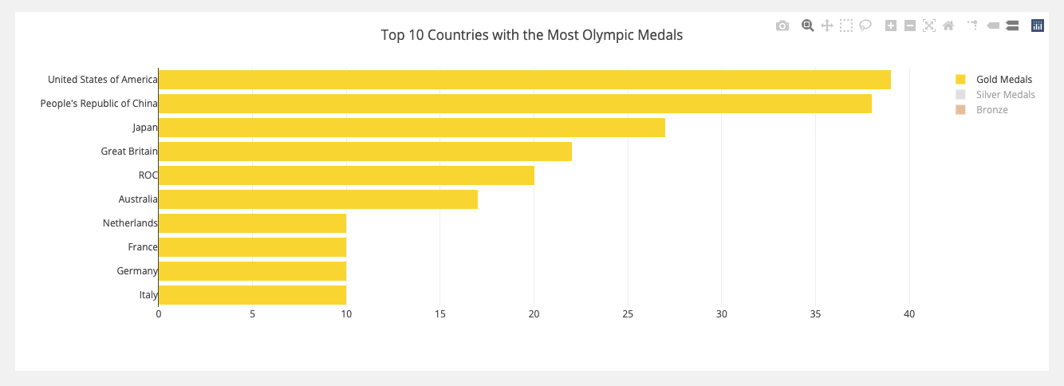
Deliverables: Medal Summary (P3)

Slide 14
Deliverables: Fun Facts (P4)
The athletes with the shortest full name:
The athletes with the longest full name:
The most popular last name is Wang with 51 entries and it’s represented in 5 different countries.
The most popular last name representing one country is Kim with 47 entries from the Republic of Korea.
Name | Country
Fu Yu | Portugal
He Li | People’s Republic of China
Name | Country
Diaa Eldin Kamal Gouda Abdelmottaleb | Egypt
Camil Inmaculada Dominguez Martinez | Dominican Republic
Brayan Santiago Rodallegas Carvajal | Colombia
Byanca Melissa Rodriguez Villanueva | Mexico
Abdelrahman Salah Orabi Abdelgawwad | Egypt

Slide 15
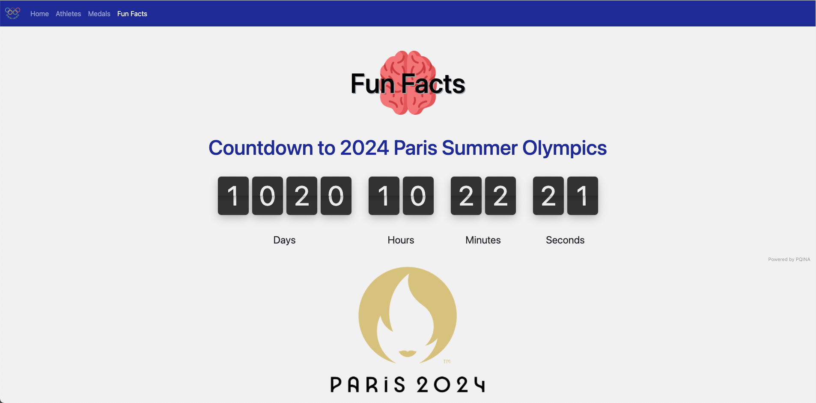
Deliverables: Fun Facts (P4)

Slide 16
Moving Forward
More visuals
Charts of medals for each country by discipline and event
Charts of the amount and type of medals won by each country by discipline and event
A heatmap of the type the numbers of medals won by each country

Slide 17
Questions?

Slide 18

Question?

Slide 19
APPENDIX
Technologies
HTML/CSS
JavaScript
Python
PostgreSQL
BootStrap
Data Source
https://www.kaggle.com/piterfm/tokyo-2020-olympics

